Slide 1

Advanced Databases ADDB6311
Simukai Musiyiwa

Slide 2

Overview of Basic Database Concepts

Slide 3
Overview of Basic Database Concepts
Data:
Raw facts; building blocks of information
Unprocessed information
Information:
Data processed to reveal meaning
Accurate, relevant, and timely information is key to good decision making
Good decision making is the key to survival in a global environment

Slide 4
Overview of Basic Database Concepts
Data Quality can be examined by observing the following characteristics of Data:
Accuracy: Is the data accurate and come from a verifiable source?
Relevance: Is the data relevant to the organisation?
Completeness: Is the required data being stored?
Timeliness: Is the data updated frequently in order to meet the business requirements?
Uniqueness: Is the data unique and there is no redundancy in the database?
Unambiguous: Is the meaning of the data clear.

Slide 5
Overview of Basic Database Concepts
A database is an organized collection of data, usually stored in a digital format.
It is a collection of records and fields.
The database is typically organized according to one of the several database models.
The design and maintenance of a complex database needs specialized skills and this task is performed by a Database Administrator (DBA).
Its supported by tools that are provided as part of the Database Management System (DBMS).

Slide 6
DBMS (Database Management System)
What is DBMS?
A DBMS is system software for creating and managing databases. The DBMS provides users and programmers with a systematic way to create, retrieve, update and manage data.
Why use a DBMS?
Reduced application development time (Queries)
Data independence and efficient access
Concurrent access
Crash recovery

Slide 7
Manual Data Processing vs. Databases
Databases have definite advantages over a manual processing system
Data Redundancy : Data stored in a manual data processing system does not have an organized structure; therefore data repetition occurs. An effectively designed database can overcome data redundancy by using various data modelling techniques.
Data Inconsistency : Databases enable you to update data consistently throughout the database
File Incompatibility : Files used in a file processing system may be of different formats, but databases overcome this by storing data in a specific structure.

Slide 8
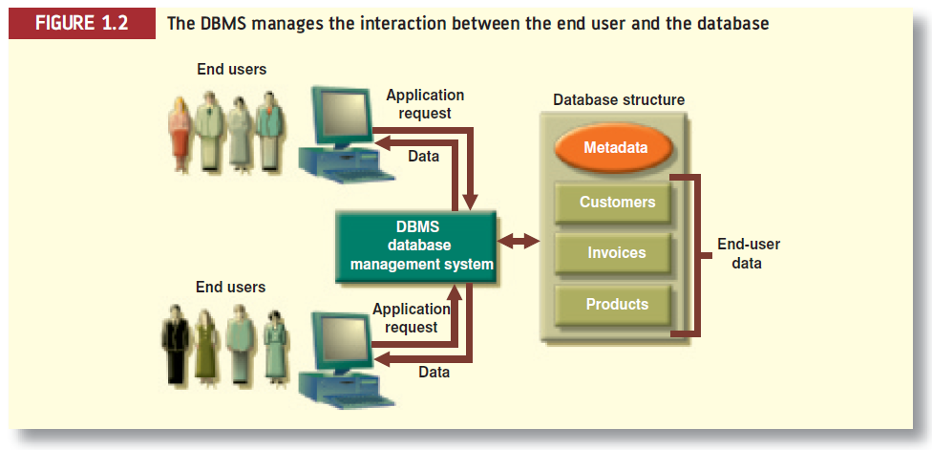
The DBMS System

Slide 9
Database Tables and Normalization
Database normalization is a process used in relational database design to organize data tables efficiently. It aims to reduce data redundancy and improve data integrity.
Purpose of Normalization:
Efficiency: Normalization ensures that data is stored in an organized manner, making it easier to add and update.
Data Integrity: It prevents anomalies (such as insert, update, and delete issues) and ensures accurate data representation.
Why Normalize a Database?:
Efficiency: Normalization makes queries run faster by minimizing redundant data.
Accuracy: It ensures consistent and accurate data.
Space Optimization: Reduces storage space.
Avoid Anomalies: Prevents insert, update, and delete anomalies.
Anomalies Explained:
Insert Anomaly: When adding data, we encounter issues due to incomplete information.
Update Anomaly: Inconsistent updates lead to data discrepancies.
Delete Anomaly: Deleting data unintentionally affects related data.

Slide 10
Database Tables and Normalization
Normalization Levels (Normal Forms):
First Normal Form (1NF): Eliminate repeating groups (e.g., multiple classes for a student).
Second Normal Form (2NF): Remove partial dependencies (attributes dependent on part of the primary key).
Third Normal Form (3NF): Eliminate transitive dependencies (attributes dependent on other non-key attributes).
When to Denormalize:
Sometimes, for performance reasons, we intentionally denormalize (combine tables) while designing databases.
Denormalization is a trade-off between efficiency and data integrity.
Remember that normalization ensures a well-structured database, balancing efficiency and accuracy

Slide 11
Summary of DBMS benefits
Reduced data redundancy and inconsistency
Enhanced data integrity
Application-data independence
Improved security
Reduced application development and maintenance costs
Improved flexibility of information systems
Increased access and availability of data and information

Slide 12

Database Models and Architecture

Slide 13
Database Models
A database model is a theory of specification describing how a database is structured and used, usually graphical, of complex real-world data structures
Flat File – Two-dimensional flat file.
Hierarchical – tree-like structure, parent child relationships.
Network – schema and subschema view of database.
Relational – related tables through common columns.
Star – fact and dimension tables, star schema.
Object- Oriented – object-oriented programming.

Slide 14
Database Model Basic Building Blocks
Entity - anything about which data are to be collected and stored
Attribute - a characteristic of an entity
Relationship - describes an association among entities
One-to-many (1:*) relationship
Many-to-many (*:*) relationship
One-to-one (1:1) relationship
Constraint - a restriction placed on the data
Business Rule - Brief, precise, and unambiguous descriptions of a policies, procedures, or principles within a specific organization

Slide 15
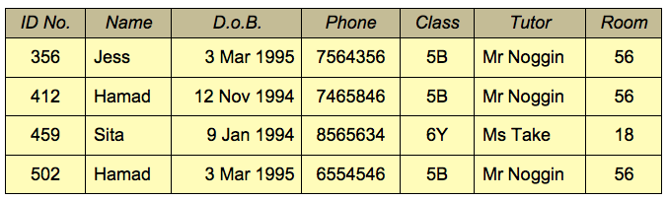
Database Models (Flat File)
This model consists of a single, 2-dimensional array of data where all column members are assumed to have similar values and row members are related to each other.

Slide 16
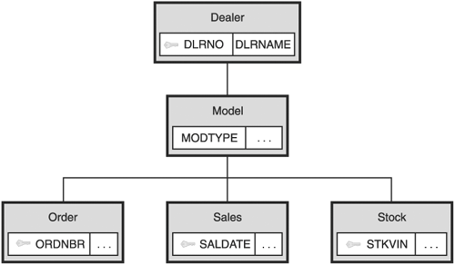
Database Models(Hierarchical)
Employs a tree like structure in which the data relationships is analogous to a parent-child relationship.
In this model a parent can have more than one child, but a child cannot have more than one parent.
Data Relationships in this model are assimilated into various levels in which files are arranged into layers or tiers
This model enhances efficiency provides greater control over a database and reduces redundancy in the database.

Slide 17
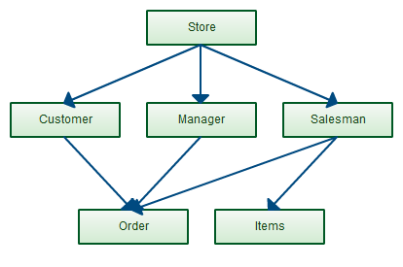
Database Models(Network)
This data model is based on the connectivity of data relationships, where multiple computers are used and information is stored and shared.
It provides two alternative views of a database – a schema and subschema.
A schema is a complete logical view of the entire database, and a subschema is a subordinate view of the database.
Further data relationships result in reduced redundancy.

Slide 18
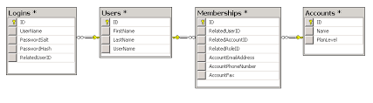
Database Models (Relational)
This data mode stores logically related data consistently in the form of related tables.
The tables are linked through common fields or columns.
The data stored is independent of the files and is managed by a central database engine that processes queries and manipulates data.
Every row of data contains an identification key that identifies data uniquely and helps in reducing redundancy.
Oracle 11g is one of the most prominently used relational database management systems for managing data

Slide 19
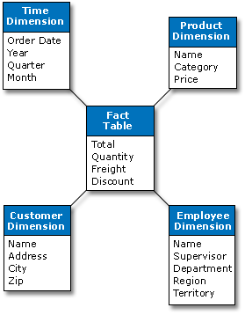
Database Models (Star)
This data model consists of one or more fact tables with many dimension tables.
The fact table consists of data recorded in events and the dimension table consists of attributes that describe the fact data.
This model reduces the number of tables thus enhances the data retrieval process.
The schema resembles a constellation of bright stars surrounded by dimmer starts, and so its referred to as the star schema.

Slide 20
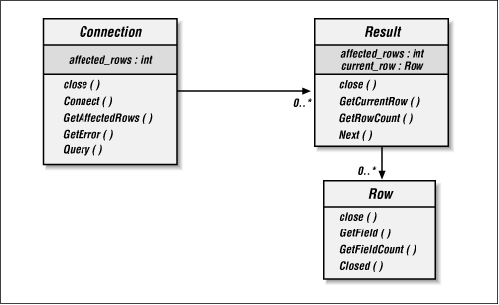
Database Models (Object Relational)
This model is designed to bridge the gap between the relational model and the object-oriented model
This model is integrated with the Object oriented programming languages.
The working approach is the same as that of the relational databases provided the database acts as an object store for the software written using Object oriented programming language.
It supports complex data creation, type inheritance, and object behavior that is related with program objects.

Slide 21
Types of Database Environments
OLTP - Online Transaction Processing (OLTP) stores and manipulates data for handling queries and transactions.
DSS - Decision Support Systems (DSS) also known as Data Warehouse, stores massive amounts of Data for generating reports. You can retrieve, analyze, extract and transform data based on your requirements.
OLAP - Online Analytical Processing (OLAP) analyzes data for mining data mining tasks such as budgeting or forecasting.
Hybrid - Acts as a multifunctional database because it supports transactional processing, ad hoc querying and batch processing.

Slide 22
Tiered Architecture
To manage data more effectively, a database is divided into layers or tiers known as the tiered architecture.
In general they are two types of tiered architecture.
The two-tiered architecture basically consists of a Server and a client where both directly interact with each other.
The multi-tired architecture supports more than two tiers, and the most widely used is the three-tier architecture consisting of three types of layers.
These Layers are namely the presentation, application and data layer

Slide 23
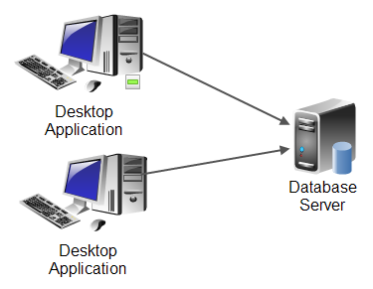
Two-tiered Architecture
This is also known as the client-server architecture.
In this type of architecture, the client sends a request to the server and the server responds to it.
One centralized server will be connected to multiple clients through dedicated networks.
Normally this will be applicable in an Intranet setup.
Additionally, the clients need a client software at their end used to initiate a connection to the server.

Slide 24
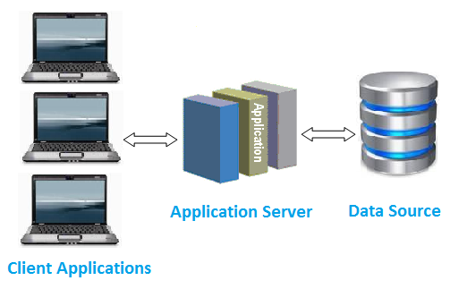
Multi-tiered Architecture (n-tiered)
This is also known as the N-Tiered architecture where N is any number greater than 2.
It helps in implementing multi-layered design where the database server is on the first tier, a centralized application server on the second tier, and the database client application is on the third tier.
The most widely used is the three-tier architecture consisting of three types of layers.

Slide 25

Structured Query Language Basics

Slide 26
Structured Query Language
SQL, the structured query language is a set of statements that can be used to retrieve, delete and modify information in a database by accessing database objects. SQL is composed of various sub languages and their associated statements
DDL – Data Definition Language (CREATE, ALTER, DROP, TRUNCATE, RENAME)
DML – Data Manipulation Language (UPDATE, DELETE, INSERT, MERGE)
DCL – Data Control Language (GRANT, REVOKE)
DQL – Data Query Language (SELECT)
TCL – Transaction Control Language (COMMIT, ROLLBACK)
SQL Cheat Sheet

Slide 27
SELECT FUNDAMENTALS
SELECT – Filters columns to be selected
FROM – Specifies tables used for select and join conditions
WHERE – defines filtering conditions and/or join conditions
GROUP BY – collects data across multiple records and groups the results by one or more columns.
HAVING – Enumerates group by results
ORDER BY – Sorts result set in a specific order by column

Slide 28
Aggregate Functions
An aggregate function performs a calculation on a set of values and returns a single value. Except for COUNT(*), aggregate functions ignore null values. Aggregate functions are often used with the GROUP BY clause of the SELECT statement.
MIN() – Filters columns to be selected
MAX() – Specifies tables used for select and join conditions
AVG() – defines filtering conditions and/or join conditions
SUM()– collects data across multiple records and groups the results COUNT() – Enumerates group by results

Slide 29
Joins
Inner Join - Returns records that have matching values in both tables.
Right Join - Return all records from the right table, and the matched records from the left table.
Left Join - Return all records from the left table, and the matched records from the right table.
Self Join – Joins to itself based on a specific column
Full Join - Return all records when there is a match in either left or right table

Slide 30


Slide 31
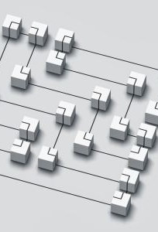
RDBMS Applications
An RDBMS is a database management system that uses the Relational database model to hold data
An RDBMS stores Data in tables called relations. These are 2-dimensional representation of data where rows are called tuples and columns are called attributes
Oracle – Owned and developed by Oracle
SQL Server – Owned and developed by Microsoft
My SQL – Owned and developed by Sun Microsystems
Sybase – Owned and developed by Sybase
DB2 – Owned and developed by IBM
PostgreSQL – Open Source Database Platform

Slide 32
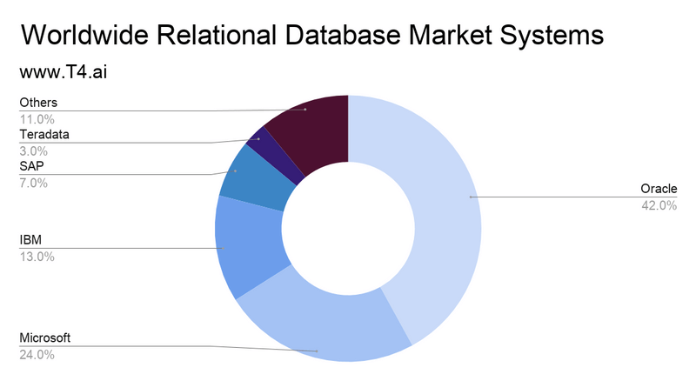
RDBMS Market Share

Slide 33



Slide 34
Oracle Editions
Oracle Database was released in the 2007 and is the most widely used database version and has various editions.
Enterprise – Servers with unlimited Sockets. It provides industries with high performance, data warehousing and mining, scalability and security.
Standard – Servers with 4 sockets. It comprises of Oracle Real Application Clusters, which provide higher availability, performance and security.
Standard Edition One – Servers with up to two sockets. It provides scalability, security, availability, performance and easy management.
Express – It is a starter database for developers, DBAs, independent software and hardware vendors, and educational institutions.

Slide 35
Advantages of Oracle RDBMS
Partition and compress tables to store more Data.
Protect and audit data to manage Historical data.
Integrate and manage the life cycle of enterprise Data.
Make use of Oracle Maximum availability architecture to achieve high availability at a lower cost and complexity.
Eliminate time-consuming error-prone administrative tasks by using features such as self-management and automation, thereby enabling the DBA to focus on strategic business policies.
It provides seamless operational efficiency regardless of the OS used so can run on Windows, Linux, Mac, Unix etc.
It also supports 64-Bit architecture to add memory space for larger applications

Slide 36
Oracle XE 23c
Oracle Database Express Edition (XE) is a community-supported edition of the Oracle Database family.
It provides a powerful Oracle Database experience, packaged for simple download, ease-of-use, and full features. Here are some key points about Oracle Database XE:
Features:
Same Core Database: Oracle Database XE is based on the same powerful Oracle Database that enterprises rely on worldwide.
Free to Use: It’s completely free to download, use, and distribute.
Embed and Redistribute: You can embed it within your applications or redistribute it as needed.
Full-Featured: Despite being free, it offers a full-featured experience.

Slide 37
Oracle Users
End User – retrieves data and uses it by initiating transactions and generating reports.
Database Developer – Designs and develops the database and the application interface that end users use to access the database.
Database Administrator – Maintains the database management system. The DBA manages, monitors, tunes, backs up and restores the database in case of system failure. Additionally the DBA is reposing for capacity planning, performance measurement , data recovery and security and hardware and software upgrades.

Slide 38
User Privileges
User privileges are the specific rights the DBA assigns to control data access and maintain database security.
These privileges are provided to the user during account creation to enable them to connect to the database, update data, and run queries.
Users are basically assigned with two types of privileges.
System privileges – perform an action on any schema object for example ALTER TABLE allows a user to alter tables in the user schema.
Object privileges – perform a particular action on a specific schema object for example selecting a row from a specific table.

Slide 39
The GRANT Statement
Using a GRANT statement users can be provided with either system or object level privileges to make changes to the database.
System level privileges often allow a user to make global changes that can affect the entire database.
The syntax for using GRANT is shown below.
GRANT privilege
ON object
TO [user | role | PUBLIC]

Slide 40
The GRANT Statement
Some system privileges are listed in the table below
Privilege | Allowable action
ALTER DATABASE | Alter the configuration of the physical database.
CREATE | ALTER ANY TABLE | Create or alter tables to be owned by another user.
DROP ANY TABLE | Drop tables owned by any user.
SELECT ANY TABLE | Select from tables owned by any user.
INSERT ANY TABLE | Insert new data into tables owned by any user.
UPDATE ANY TABLE | Modify existing data in tables owned by any user.

Slide 41
Separation of Duties
The separation of duties ensures that no single individual has complete control over critical tasks within an organization. By dividing responsibilities among different users or roles, it prevents fraud, detects errors, enhances accountability, and ensures compliance with regulations.
This practice introduces checks and balances, promoting security and integrity in organizational operations. Separation of duties is important for security and accountability reasons.
By assigning specific privileges to different users, you can ensure that:
Access Control: Each user only has access to the data and operations that are necessary for their role. This helps prevent unauthorized access and reduces the risk of data breaches.
Accountability: With separate user accounts and assigned privileges, it's easier to track who performed which actions in the database. This is crucial for auditing and accountability purposes.
Risk Management: Limiting privileges to only what is necessary for each user reduces the potential impact of security incidents or mistakes. It minimizes the risk of accidental data loss or corruption.
Compliance: Separation of duties helps organizations comply with regulatory requirements and industry standards by implementing proper access controls and security measures.
Role Separation : This segmentation guarantees that functions like as database management, data entry, and data verification are carried out by separate personnel with appropriate privileges, preventing any single user from exercising disproportionate control over the system. Furthermore, the division of roles protects against fraud and errors by creating checks and balances inside the system.
By following the principle of least privilege and separating duties among users, organizations can enhance the overall security and integrity of their database systems. Overall, the separation of roles is crucial for increasing the reliability, accuracy, and trustworthiness of database systems in businesses.

Slide 42
Oracle Program Categories
Oracle Interface – The Oracle interface is an application that enables you to connect to a Oracle Database.
Oracle SQL Developer – a GUI based Oracle Interface.
SQL*Plus – a Command Line based Oracle interface.
The Oracle Enterprise Manager – helps businesses to achieve the highest quality of service at the lowest IT operational costs.
The Oracle Recovery Manager – is responsible for managing the backup and recovery for all Oracle data formats.

Slide 43
SQL*Plus
SQL*Plus is an application from Oracle that provides a command line interface for DBAs, Developers and end users to connect and disconnect from the Oracle server.
It is independent of any database version or operating system, allowing a single workstation to seamlessly connect to all available Oracle Database Servers.
SQL*Plus runs both SQL and PL\SQL commands interactively.
SQL*Commands are store in special files called scripts that, which can be saved, edited and called from the command prompt.

Slide 44
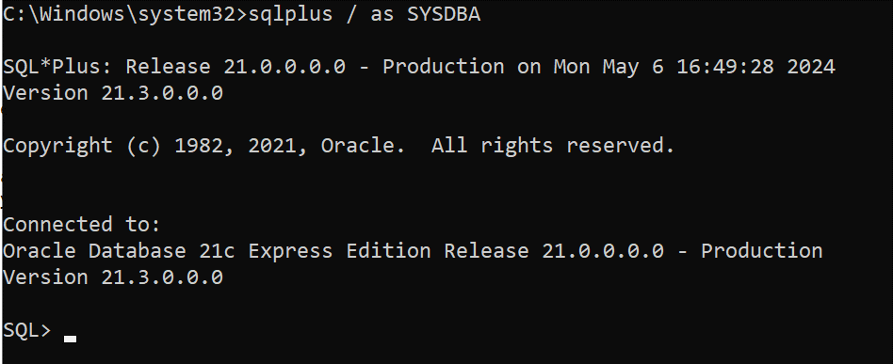
SQL*Plus

Slide 45
SQL Developer
Oracle SQL Developer is a free fully supported graphical tool for database development.
It is used to browse database objects, run SQL statements and scripts, edit and debug PL\SQL statements.
SQL Developer can connect to any Oracle Database version.
It is compatible with Windows, Linus and Mac OS X.
Oracle SQL Developer is a powerful tool designed for database developers and administrators.
SQL Developer provides a convenient way to perform various tasks related to Oracle Database and other databases.

Slide 46
SQL Developer
Functionality:
Database Browsing: You can browse, create, edit, and delete database objects (tables, views, indexes, etc.).
SQL Execution: Run SQL statements and scripts.
PL/SQL Development: Edit and debug PL/SQL code.
Data Manipulation: Manipulate and export data.
Reporting: View and create reports.
Database Connections: Connect to various databases using standard authentication.
Migration: Migrate non-Oracle databases (e.g., MySQL, Microsoft SQL Server) to Oracle Database.
Supported Databases
Oracle Database (target schemas).
MySQL.
Third-party databases (e.g., Microsoft SQL Server, Sybase, IBM DB2)
In summary, Oracle SQL Developer streamlines database-related tasks, making it an essential tool for developers and administrators.

Slide 47
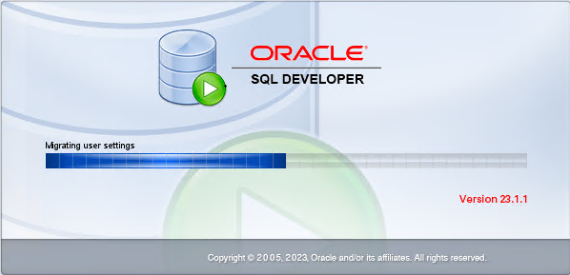
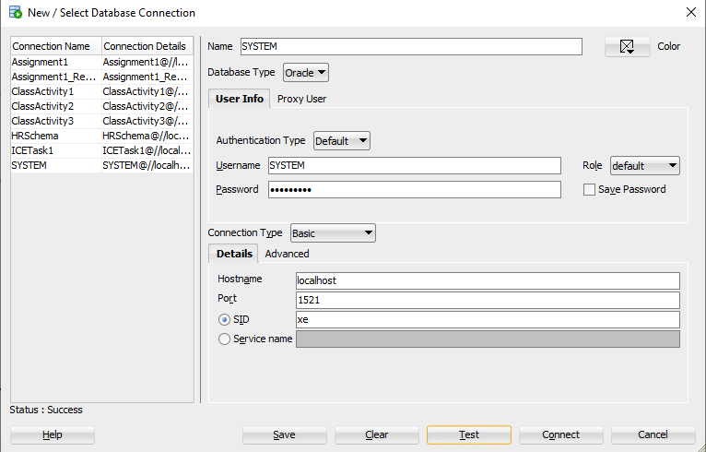
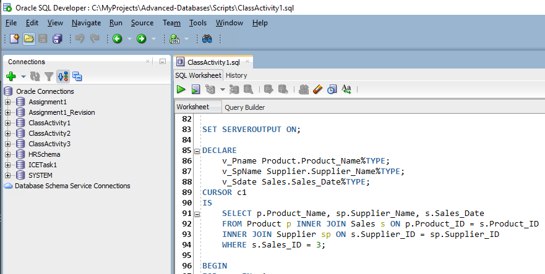
SQL Developer

Slide 48

Oracle 21c Express Edition comes with a single
Default database called XE
xe
ClassActivity1
ICETask1
Test1
Asignment1
A schema is a user that own objects

Slide 49
Creating a System connection to the XE Database

Slide 50
Creating a new Schema using System
--Enable non compatible user naming
ALTER SESSION SET "_ORACLE_SCRIPT"=TRUE;
--Enable Oracle to display results of Query and block execution in results plane
SET SERVEROUTPUT ON;
--Create a user called SchemaName to be assigned a schema role
CREATE USER Assignment1 IDENTIFIED BY Password1;
GRANT ALL PRIVILEGES TO Assignment1;
COMMIT;
--Connect to the schema after creation using the GREEN PLUS icon in the Connections Plane

Slide 51
Data Dictionary
A set of information describing the contents, format, and structure of a database and the relationship between its elements, used to control access to and manipulation of the database.
Name of the data item;
Aliases or other names that may be used to describe the item;
Range of values that can be used;
Type of data (such as alphanumeric or numeric);
Amount of storage needed for the item;
Notation of the person responsible for updating it and the various users who can access it;

Slide 52
(DBA)Database Administrator Tasks
Installing and maintaining Oracle Software.
Initiating and restoring the Database Environment (DBE).
Accepting and rejecting changes in the schema and database design.
Creating and controlling the schema object.
Managing data security, database backup and recovery
Managing all transactions, locks and logs
Updating the database with new releases
Monitoring the database, tuning its performance, and implementing preventative measures to avoid system crashes
Analyzing the future requirements of the database

Slide 53
Supported Oracle Data Types
Data Type | Category | Description
CHAR | string | Fixed Length character data type.
VARCHAR2 | string | Variable Length character data type.
NVARCHAR2 | string | Variable Length character data type.
INT, BIGINT, SMALLINT | numeric | Integer Data Type
NUMBER | numeric | Integer Data Type
NUMBER(p,s) | float | Float Data type with precision and scale
DATE | date | Date
TIMESTAMP | time | time

Slide 54
PL\SQL
Procedural Language\Structured Query Language (PL\SQL) is a procedural language developed by Oracle as an extension to SQL.
PL\SQL combines the capabilities of procedural logic with the simplicity of SQL commands.
It is modular and portable, and enables the execution of procedural techniques and logic on a database with conditional, iterative and sequential statements.
The programs written with this language have block structures containing procedures, functions and blocks as their basic units.

Slide 55
Features of PL/SQL
PL/SQL provides many features that allow you to write effective code to manipulate your database;
It is a procedural language extension of SQL, it allows you to use SQL commands, functions and operators;
It supports SQL data types and allows SQL statements to be constructed and executed;
PL/SQL is a block-structure language, meaning blocks of code are passed to the Oracle Server, instead of one command being passed at a time, thus increasing performance and decreasing network traffic.
A PL\SQL program is portable in any platform on which Oracle works
With PL/SQL you can write portable programs and reuse them in different environments without any change at all.

Slide 56
Features of PL/SQL ….continued..
Block Structure – PL/SQL is a language composed of blocks of code that can be nested within each other. Each block refers to a particular task or module, allowing you to create modular code.
Procedural capabilities – PL/SQL defines procedural constructs such as conditional logic and loop[s. Conditional logic includes IF..THEN..ELSE statements, and loops include WHILE statements, which are used to execute a set of statements repeatedly until a specific condition is met.
Error Handling - Certain types of Errors called exceptions, can be trapped during PL/SQL program execution. Once an exception is trapped, corrective or diagnostic actions can be performed.
Complete Portability – You can run application written in PL/SQL on any Operating System and platform where the Oracle database runs.
Tight Integration with SQL – PL/SQL allows you to use SQL commands, functions and operators. You dnt have to translate between PL/SQL and SQL data types.

Slide 57
Components of the PL/SQL Environment
A typical PL/SQL environment includes several major components
Database Server
Database
Application Server
Application Server Software
Client Computer
Network

Slide 58

The PL\SQL Block
The PL/SQL Block
%TYPE Attribute
%ROWTYPE Attribute
Implicit Cursors
Explicit Cursors
Cursor FOR LOOP

Slide 59
The PL\SQL Block
(PL\SQL) programs are known as blocks.
PL\SQL blocks are broken into three sections : Declaration, Execution and Exception Handling.
PL\SQL provides two types of blocks: Named blocks and anonymous blocks.
Named blocks are stored in the Data Dictionary of the database and executed when called. These blocks can be stored as procedures, functions or triggers.
Anonymous blocks are PL\SQL blocks that are not named and are executed at runtime from an interface that can access the database.
All code for the anonymous block must be passed to the database at time of execution

Slide 60
The PL\SQL Block
DECLARE
--Variables are declared in this section
BEGIN
--The program logic is defined and executed in this section
EXCEPTION
--Exception handling is done in this section trapping any error prone situations that may arise during program execution
END;
/

Slide 61
%TYPE Attribute (Data type Anchoring)
The %TYPE attribute provides data types of variables or database columns.
This comes in handy while declaring variables that will hold database values.
Declaring variables with %TYPE has two advantages. First you need not know the exact datatype of the declared variable..
Second if you change the database definition, perhaps to make it a longer character string, the data type of the declared variable changes accordingly at runtime.

Slide 62
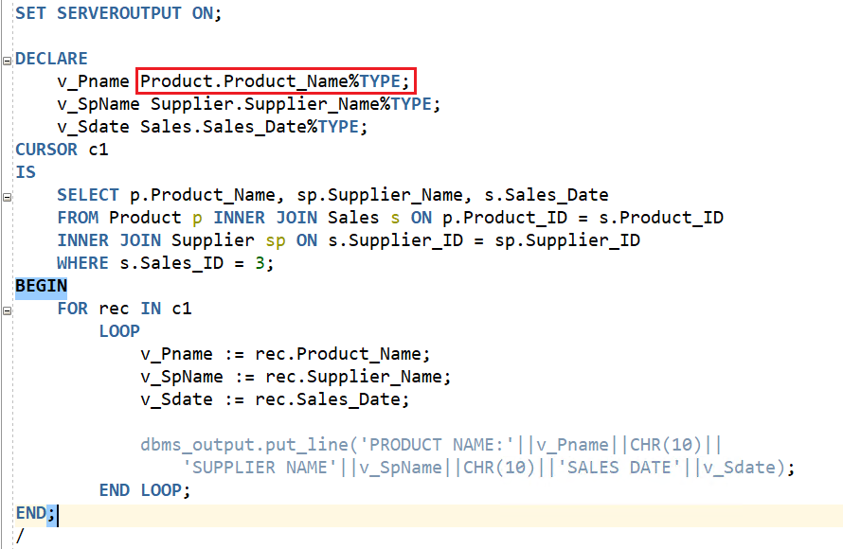
%TYPE Attribute Example

Slide 63
%ROWTYPE Attribute
The %ROWTYPE attribute provides a record type that represents a row in a table.
The record can store an entire row of data selected from the table or fetched from a cursor variable.
Columns in a row and corresponding fields in a record have the same name and datatypes.
%ROWTYPE simplifies working with entire rows of data from a table as it allows you to create a record variable that has the same structure as a table row.

Slide 64
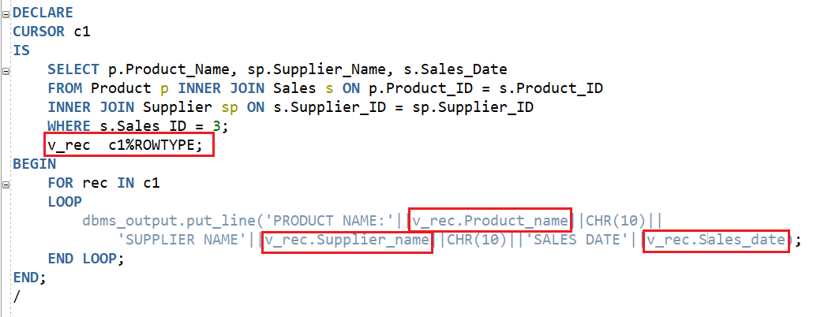
%ROWTYPE Attribute Example

Slide 65
SELECT .. INTO
In PL/SQL, the SELECT .. INTO statement is used to select a single row from a database table into variables.
This is useful when you want to retrieve data from the database and store it in PL/SQL variables for further processing.

Slide 66
Explicit vs Implicit Cursors
Implicit Cursors
They are created automatically by Oracle.
All SQL statements that handle data directly, including SELECT, INSERT, UPDATE, and DELETE statements use implicit cursors.
During processing, the cursor is created and opened automatically, and the data is fetched from the database or the user process and is stored in the cursor.
The data is processed depending on the SQL statement issued.
Explicit Cursors
They are created manually from within PL\SQL.
Process rows in a result set individually, to take a different action for each row based on the values in that row
They are declared within the declaration section of a PL\SQL block, and are given a name and a definition in the form of a SELECT statement.

Slide 67
Explicit Cursors
Programmers are allowed to create named context area to execute their DML operations to get more control over it. The explicit cursor should be defined in the declaration section of the PL/SQL block, and it is created for the ‘SELECT’ statement that needs to be used in the code.
Below are steps that involved in working with explicit cursors.
Declaring the cursor: Declaring the cursor simply means to create one named context area for the ‘SELECT’ statement that is defined in the declaration part. The name of this context area is same as the cursor name.
Opening Cursor: Opening the cursor will instruct the PL/SQL to allocate the memory for this cursor. It will make the cursor ready to fetch the records.
Fetching Data from the Cursor: In this process, the ‘SELECT’ statement is executed and the rows fetched is stored in the allocated memory. These are now called as active sets. Fetching data from the cursor is a record-level activity that means we can access the data in a record-by-record way. Each fetch statement will fetch one active set and holds the information of that particular record. This statement is same as ‘SELECT’ statement that fetches the record and assigns to the variable in the ‘INTO’ clause, but it will not throw any exceptions.
Closing the Cursor: Once all the record is fetched now, we need to close the cursor so that the memory allocated to this context area will be released.

Slide 68
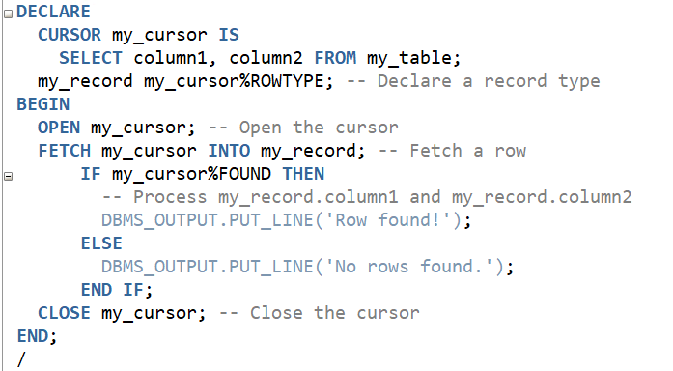
Explicit Cursors Syntax

Slide 69
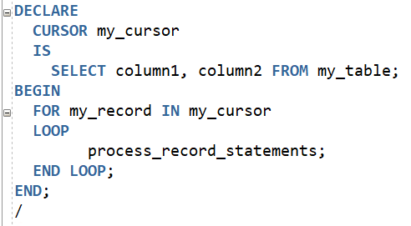
CURSOR FOR LOOP
In PL/SQL , a CURSOR FOR LOOP is a convenient way to iterate through the result set of a query without explicitly opening, fetching, and closing the cursor.
It simplifies the process of fetching rows from a cursor and processing them.
The FOR my_record IN my_cursor construct automatically opens the cursor, fetches each row, assigns the values to my_record, and closes the cursor when done.
It’s concise and reduces the boilerplate code compared to using explicit OPEN, FETCH, and CLOSE statements.

Slide 70
Sub Programs
Procedures
Functions
Triggers
External Procedures

Slide 71
Subprograms
PL\SQL subprograms are named PL\SQL blocks that can be called with a set of parameters.
A Subprogram can either be a procedure or a function.
Procedures are used to perform actions and functions are used to calculate and return a value.
Benefits of Subprograms
You can use subprograms because they offer you real-time benefits such as modularity, efficiency, reusability and maintainability.

Slide 72
Benefits of Subprograms(continued..)
Modularity - Subprograms let you break a program down into manageable, well-defined modules. You can use top-down design and the stepwise refinement approach to problem solving.
Efficiency - Subprograms let you extend the PL/SQL language. Procedures act like new statements. Functions act like new expressions and operators.
Re-usability - Subprograms promote reusability. Once tested, a subprogram can be reused in any number of applications. You can call PL/SQL subprograms from many different environments, so that you do not have to reinvent the wheel each time you use a new language or API to access the database
Maintainability - Subprograms promote maintainability. You can change the internals of a subprogram without changing other subprograms that call it. Subprograms play a big part in other maintainability features, such as packages and object types
Dummy subprograms - Dummy subprograms (stubs) let you defer the definition of procedures and functions until after testing the main program. You can design applications from the top down, thinking abstractly, without worrying about implementation details.

Slide 73
Procedures
A PL/SQL procedure serves several purposes:
Modularity: Procedures allow you to break down complex tasks into smaller, manageable units.
Reusability: Once defined, procedures can be called from various parts of your application.
Encapsulation: Procedures encapsulate specific functionality, promoting better code organization.
Performance: By reducing redundant code, procedures enhance performance.

Slide 74
Uses of Functions in PL/SQL
In PL/SQL, a function is a reusable program unit that performs a specific task and returns a value.
Functions are similar to procedures, but they must always return a result.
PL/SQL consists of blocks of code, which can be nested within each other. Each block performs a unit task or a logical module.
PL/SQL Blocks can be stored in the database and can be reused.
PL/SQL engine enhances the performance by processing multiple SQL statements simultaneously as a single block and reducing network traffic.
PL/SQL improves error handling capacity by handling errors or exceptions effectively during the execution of PL/SQL programs.

Slide 75
Procedures vs Functions
Functions are mainly used when a single value is to be returned. A procedure may or may not return a value or may return more than one value up to 1024.
Functions can be called from SQL statements whereas procedures cannot be called from SQL statements.
Functions are normally used for computations whilst procedures are mainly used for executing business logic.
Functions also contain DML statements, but such a function cannot be called in a SQL Query.
A function return type can be scalar, table or table values. Stored Procedures always return integer values by default zero.

Slide 76
Triggers
Triggers are special PL/SQL program units that are stored in a database, and they are automatically executed in response to certain events such as data modifications.
Triggers are necessary to automate tasks within the database.
The modification statement may include INSERT, DELETE, and UPDATE statements, and they may be database related statements such as ALTER, LOGON and SHUTDOWN.
Triggers can be enabled and disabled when necessary.
Depending on the various tasks to be performed, triggers can be catergorised into the following;
Table-Level\Row-level Trigger
Event Level Trigger
Compound Trigger

Slide 77
Triggers … continued..
Table-Level\Row-level Trigger – is associated with a table and is executed when a specified action occurs on a table. These actions are performed by the INSERT, UPDATE, or DELETE statements. A single trigger may fire either BEFORE, or AFTER these actions occur on the table
Event Level Trigger – fires when certain events occur within the database, or the DDL statements are issued. It includes various triggers such as;
The CREATE, ALTER and DROP trigger that is fired when the specified DDL statements are issued.
The LOGON\LOGGOFF triggers that are fired when users login or off the database.
The STARTUP or SHUTDOWN trigger that is fired when STARTUP or SHUTDOWN commands are issued.
3. Compound Trigger - A compound trigger combines the features of a row-level and event level triggers.

Slide 78
Other Database Objects
Views
Sequences
Synonyms
Indexes

Slide 79
Views
A view is a virtual table that contains data from one or more underlying tables. It is essentially a named query or a stored query.
Views are used to simplify complex queries, provide security, and enhance data organization.
It does not store data itself; instead, it derives its data dynamically from the underlying tables whenever it is queried.
Benefits of Views:
Security: Views allow you to control access to sensitive data by exposing only specific columns or rows.
Abstraction: Views simplify complex queries by encapsulating logic.
Data Organization: Views help organize data by providing a logical layer on top of tables.

Slide 80
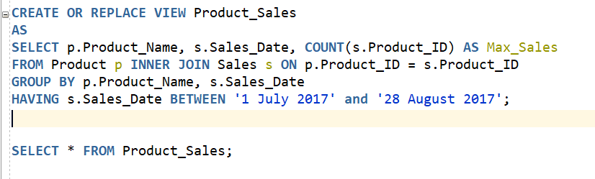
Views

Slide 81
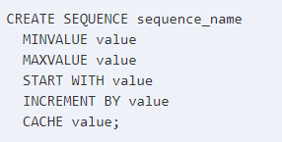
Sequences
In Oracle, you can create an auto-number field by using sequences.
A sequence is an object in Oracle that is used to generate a number sequence.
This can be useful when you need to create a unique number to act as a primary key.

Slide 82
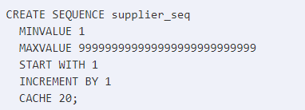
Sequences
Now that you've created a sequence object to simulate an autonumber field, we'll cover how to retrieve a value from this sequence object.
To retrieve the next value in the sequence order, you need to use nextval.
INSERT INTO suppliers (supplier_id, supplier_name) VALUES (supplier_seq.NEXTVAL, 'Kraft Foods');

Slide 83

Synonyms
A synonym is an alternative name for objects such as tables, views, sequences, stored procedures, and other database objects.
You generally use synonyms when you are granting access to an object from another schema and you don't want the users to have to worry about knowing which schema owns the object.
The syntax to create a synonym in Oracle is:

Slide 84
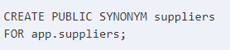
Synonyms
OR REPLACE
Allows you to recreate the synonym (if it already exists) without having to issue a DROP synonym command.
PUBLIC
It means that the synonym is a public synonym and is accessible to all users. Remember though that the user must first have the appropriate privileges to the object to use the synonym.
schema
The appropriate schema. If this phrase is omitted, Oracle assumes that you are referring to your own schema.

Slide 85
Synonyms
object_name
The name of the object for which you are creating the synonym. It can be one of the following:
tables
views
sequence
stored procedure
function
package
The syntax to drop a synonym in Oracle is:
PUBLIC
Allows you to drop a public synonym. If you have specified PUBLIC, then you don't specify a schema.
force
It will force Oracle to drop the synonym even if it has dependencies. It is probably not a good idea to use force as it can cause invalidation of Oracle objects.

Slide 86

Handling Exceptions

Slide 87
Handling Exceptions
In PL/SQL errors are referred to as Exceptions is a program written in a non PL/SQL
PL/SQL raises an exception for a system generated error or an error caused by the user.
Exceptions can also be warnings the application issues to the user.
When an exception is raised, the execution of the current block stops and the control transfers to the exception section.
After handling the exception ,control doesn’t go back to the block whose execution halted.
DECLARE
--Variables are declared in this section
BEGIN
--The program logic is defined and executed in this section
EXCEPTION
--Exception handling is done in this section trapping any error prone situations that may arise during program execution
END;

Slide 88
Handling System Defined Exceptions
Predefined Exceptions:
These are internally defined exceptions with predefined names, declared globally in the STANDARD package.
The runtime system raises these exceptions implicitly (automatically).
Because they have names, you can write specific exception handlers for them.
User-Defined Exceptions:
You can define your own exceptions in PL/SQL according to your program’s needs.
User-defined exceptions must be raised explicitly using either a RAISE statement or the DBMS_STANDARD.RAISE_APPLICATION_ERROR procedure

Slide 89
Handling User Defined Exceptions
Exception handling is a mechanism for dealing with runtime errors caused by running a PL/SQL program
In PL/SQL, user-defined exceptions allow you to handle specific error conditions in your code. You can declare custom exceptions and raise them when necessary.
Exception handling occurs in the following sequence.
Declaring the Exception
Raising the Exception.
Raising the Exception

Slide 90
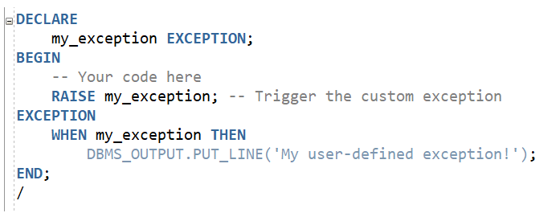
Handling User Defined Exceptions

Slide 91
Advantages of Exceptions
Potential errors from many statements can be handled using a single exception handler.
Keeping error handling routines separate makes the rest of the PL/SQL block easier to read and understand.
Instead of troubleshooting for an error at every probable instance, adding an exception handler to the block will handle the error in the event that the exception being raised is in that block.

Slide 92
Predefined System Exceptions
System defined exceptions occur whenever a program violates a rule of the RDBMS and are raised automatically.
System Exception | Occurs
NO_DATA_FOUND | When a SELECT..INTO does not return any row.
TOO_MANY_ROWS | When a SELECT..INTO does not returns more than one row.
ZERO_DIVIDE | When you attempt to divide a number by zero.
PROGRAM_ERROR | When an unknown internal error occurs in PL/SQL
LOGON_DENIED | When you login with an invalid username or password.
CURSOR_ALREADY_OPENED | When you open a cursor that is already open
INVALID_CURSOR | When you perform an invalid operation on a cursor such as closing a cursor that is not open.
STORAGE_ERROR | When your System runs out of memory

Slide 93

Conditional Control Statements

Slide 94
Conditional Control Statements (IF)
Conditional statements give you the ability to direct the flow of execution in your program based on a condition.
In Oracle this is achieved using the IF and CASE statements.
Oracle supports 3 forms of the IF statement
IF Statement | Description
IF-THEN | Evaluates of a single condition and if TRUE performs a specific action/s
IF-THEN-ELSE | Allows a choice between two actions base on the evaluation of a single condition.
IF-THEN-ELSE-IF | To allows for the evaluation of additional conditions ELSIF is used. Any number of ELSIF clauses can be used within a IF statement. Conditions are evaluated one at a time from top to bottom. If any condition is TRUE, its action is executed and control is passes to the next statement. If all conditions are FALSE or NULL the sequence in the ELSE is executed.

Slide 95
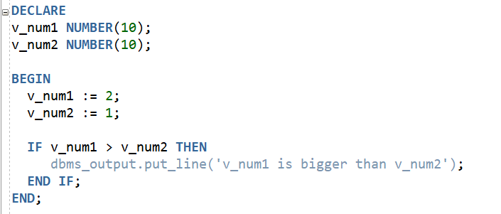
Example - (IF-THEN)

Slide 96
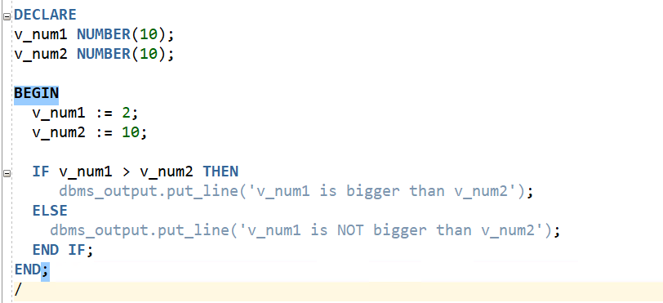
Example (IF-THEN-ELSE)

Slide 97
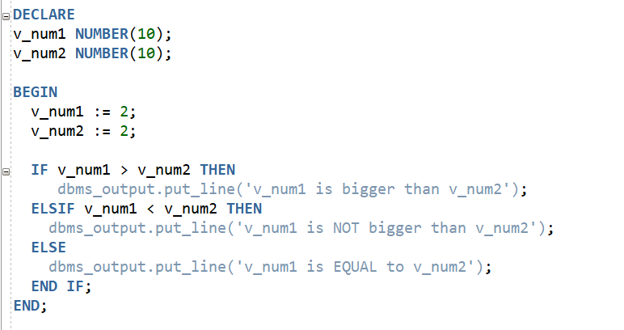
Example (IF-THEN-ELSIF)

Slide 98
Conditional Control Statements (CASE)
The CASE statement selects one sequence of statements to execute using a selector.
A selector is an expression whose value is used to select one of several alternatives.
Lengthy IF-THEN-ELSE statements can be rewritten as CASE statements to make them more readable and efficient.
The else clause is optional.
CASE [ SELECTOR ]
WHEN --condition1 THEN --action1
WHEN --condition2 THEN --action2
WHEN --condition3 THEN --action3
ELSE --alternate action
END;

Slide 99

External Procedures

Slide 100
External Procedures
An External Procedure is a program written in a non-PL/SQL programming language and are also known as External Routines.
External programs are more frequently used in applications of computation purposes, and enable you to:
Move computation-bound programs from the client to the server since it enables faster execution.
Interface the database server with external systems and data sources.
Extend the functionality of the database itself

Slide 101
Benefits of External Procedures
An External Procedure is a program written in a non PL/SQL programming language and are also known as External Routines.
They are several benefits to using external procedures
Integration of strengths
Reusability of client logic.
Logical extensibility.
Enhanced Performance

Slide 102
External Procedures Execution process
User invokes function
Server process executes the function
Server process looks for the alias directory
Server passes the request to the listener
Listener activates extproc process for the current session
Extproc process loads shared library
Extproc links server to external DLL and executes procedure
Data returned from the function is sent back

Slide 103
YouTube Links
https://www.youtube.com/watch?v=xofpqdU3cD4
https://www.youtube.com/watch?v=ihuXf6PySg4
https://www.youtube.com/watch?v=qDRZ_J2cdCc
https://www.youtube.com/watch?v=ga8q90XFqDk
Oracle SQL Tutorial 1 - Intro to Oracle Database (youtube.com)

Slide 104
References
Masterskill: Oracle Database 11g – Anitha R
https://www.techonthenet.com/oracle/

Slide 105


